Slide 2
Building a real-time news feed and toast notifications on SharePoint with SPFx and webhooks
Giuliano De Luca

Slide 4

Giuliano De Luca
Software Engineer Technical Architect
Independent
https://delucagiuliano.com
@giuleon
Microsoft MVP for Office Development
github.com/giuleon

Slide 5
Agenda
Solution Architecture
SharePoint Framework
Webhooks
4 demos
Resources

Slide 6

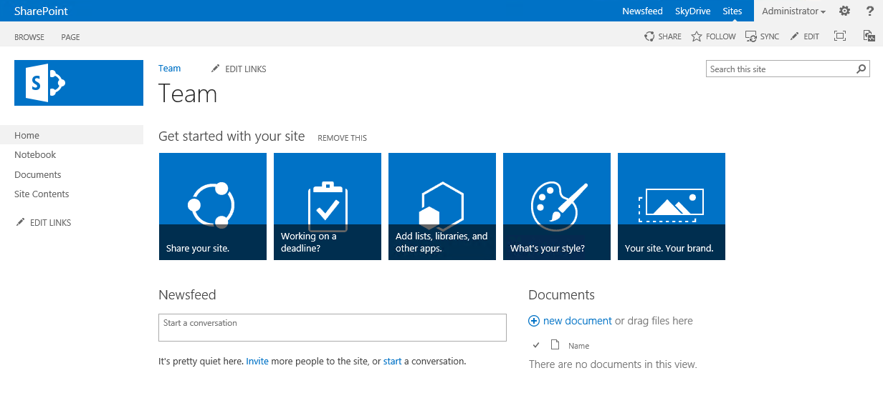

Solution Architecture
Azure
Web App
SharePoint Online List
After the webhooks subscription, every list changes trigger an HTTP POST towards the subscriber
1
Node JS Web App
2
SharePoint Framework
Socket.io Broadcast
SignalR

Slide 7
SharePoint Framework
S
P
F
X

Slide 8
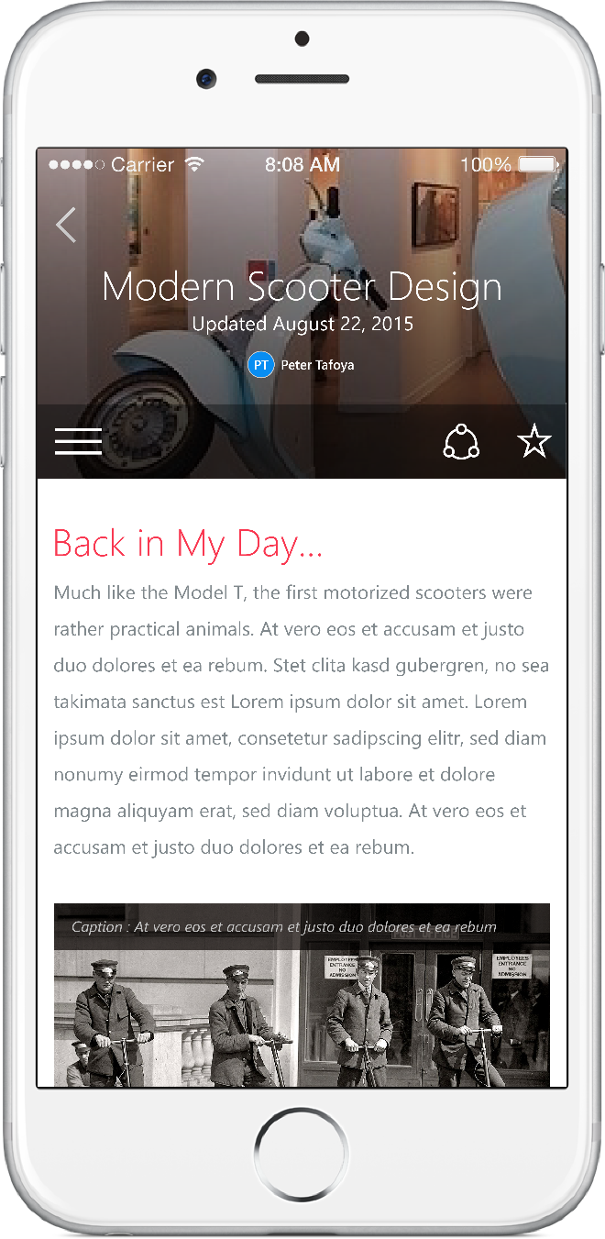
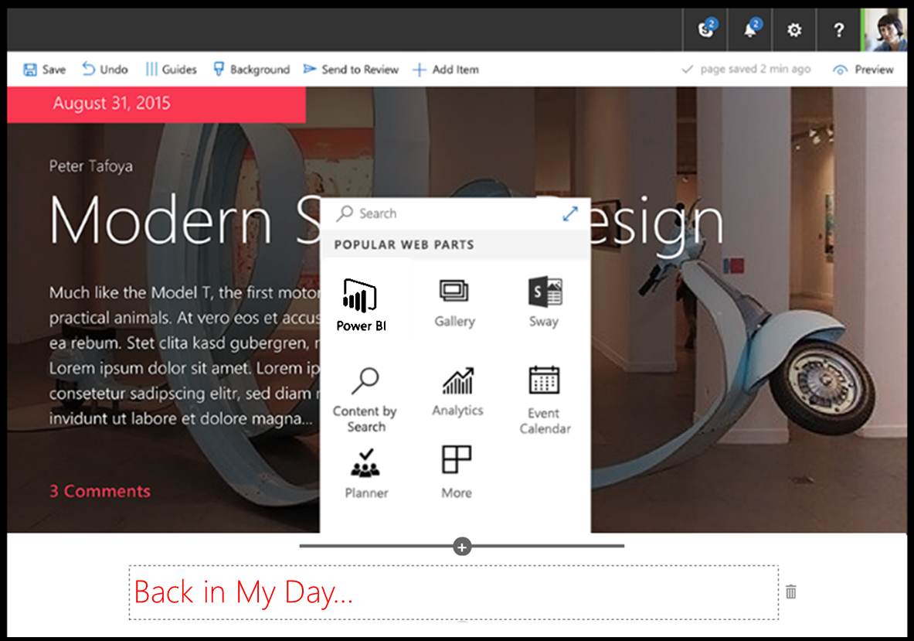
SharePoint Framework
Modern client-side development
Lightweight web and mobile
Powers our own experiences
Backward compatible
Supports open source tools and JavaScript web frameworks
SharePoint framework
Microsoft Graph
LOB Systems and Cloud Services

Slide 9
What can we create with SPFx?
Client-Side Web Parts
Client-Side Extensions
Application Customizer
Command Set
Field Customizer

Slide 10





SharePoint Framework Toolchain
Tooling
Node.js
Yeoman
Gulp
TypeScript
Visual Studio (Code)
Frameworks – Choose yours
React
Angular.js
Knockout
Etc.

Slide 11




Comparing tools with Microsoft
IIS Express
MS Build
VS Project →
New → <Template>

Slide 12
What is Node.js?
Run server-side JavaScript
Makes use of Google’s V8 JavaScript engine
Supports the latest ECMAScript features
Open source
Cross-platform
“Can” act as a web server, but more is possible
Check your version: node -v

Slide 13
Nodejs App

Slide 14
SharePoint webhooks

Slide 15
What are webhooks?
A way to be notified of a done change
Push model instead of Pull model
Universal model used by many services (WordPress, GitHub, MailChimp, ...)
First made available in OneDrive and Outlook
Now available in SharePoint Online

Slide 16




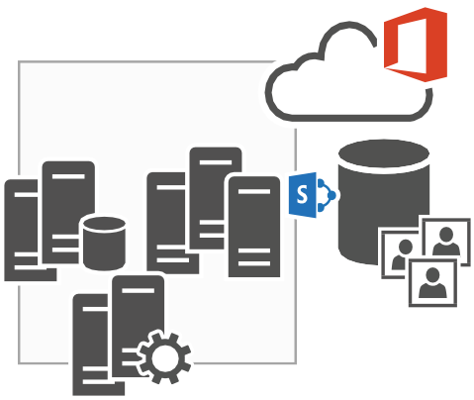

Subscribe to a Webhook
POST /_api/web/lists('list-id')/subscriptions
Application
SharePoint Service
Content-Type: application/json
{
"resource": "https://contoso.sharepoint.com/_api/web/lists({id})", "notificationUrl": "https://{your host}/your/webhook/service", "expirationDateTime": "2017-06-18T16:17:57+00:00"
}

Slide 17
Subscribe to a Webhook
Application
SharePoint Service
Your WebHook notification service endpoint
POST https://{your host}/your/webhook/service
?validationToken={randomString}

Slide 18
Subscribe to a Webhook
Application
SharePoint Service
HTTP/1.1 200 OK
Content-Type: text/plain
{randomString}

Slide 19
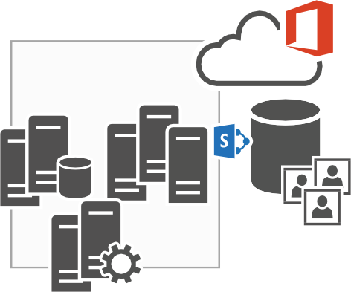

Subscribe to a Webhook
Application
SharePoint Service
Your WebHook notification service endpoint
HTTP/1.1 201 Created
Application
Content-Type: application/json
{
"id": "a8e6d5e6-9f7f-497a-b97f-8ffe8f559dc7", "expirationDateTime": "2017-06-18T16:17:57Z", "notificationUrl": "https://{your host}/your/webhook/service", "resource": "{id}"
}

Slide 20

Event Notification
SharePoint Service
POST https://{your host}/your/webhook/service
Your WebHook notification service endpoint
{
"value":[
{
"subscriptionId":"91779246-afe9-4525-b122-6c199ae89211", "clientState":"00000000-0000-0000-0000-000000000000",
"expirationDateTime":"2017-06-18T17:27:00.0000000Z", "resource":"b9f6f714-9df8-470b-b22e-653855e1c181", "tenantId":"00000000-0000-0000-0000-000000000000",
"siteUrl":"/",
"webId":"dbc5a806-e4d4-46e5-951c-6344d70b62fa"
}
]
}

Slide 21
Event Notification
SharePoint Service
Your WebHook notification service endpoint
HTTP/1.1 200 OK

Slide 22
Supported Events
Item Add
Item Delete
Item Update
Item Attachment Add
Item Attachment Delete
Item Check In
Item Check Out
Item Uncheck Out
Item File Move
Item File Convert
Item Version Delete

Slide 23
WebHook Advantages
WebHooks have a retry mechanism with an incremental back off strategy (5 times with 5 minute interval)
WebHooks are secure as no event information is passed along during the notification
WebHooks are easier to consume by “non-SharePoint” developers
No WCF based endpoints, regular HTTP services are sufficient (e.g. Web API)

Slide 24
Subscription Renewal
WebHooks have an expiration date of maximum 6 months after creation
You can “renew” a WebHook via a REST call
PATCH /_api/web/lists('list-id')/subscriptions('subscriptionID’)
Two patterns are possible:
Have a background job that regularly renews the needed subscriptions (recommended model)
Renew at notification time (will drop WebHook if there’s no event within the defined expiration window)

Slide 25
Webhooks subscription with nodejs

Slide 26
Client Mechanism - Get Changes API
let changeToken = `1;3;${resource};${this.toTicks(this._lastQueryDate)};-1`;
{
Add: true,
Item: true,
ChangeTokenStart: { StringValue: changeToken }
}
Version Number
Change Scope
GUID of list
date and time when changes occurred
the change item value on the ChangeToken (initialize with a value of -1)

Slide 27
Real-time news feed and toast notifications

Slide 28
Resources
SPFx People Picker - https://goo.gl/iRZZd7
SharePoint Add-In People Picker - https://goo.gl/SEUflx
SPFx All property types - https://goo.gl/Y46vkA
SPFx React chart web part - https://goo.gl/NmRG7j
SPFx React weather web part - https://goo.gl/uXnZJd
Nodejs App – Socket.io server - https://goo.gl/c4UiKW
SPFx Real-Time news feed - https://goo.gl/aDQ9W3
SPFx Toast Notifications - https://goo.gl/s2c22v
SharePoint Framework - https://goo.gl/SJ1VHW
Office UI Fabric - https://dev.office.com/fabric

